Slide 1

DISCLAIMER
The information in this presentation is provided to you by PT. AXAR Technology Raya, solely for informational purposes and does not constitute an offer to buy, sell or issue, or a solicitation of an offer to sell, buy or acquire any securities of the Company in any jurisdiction or an inducement to enter into investment activity, nor may it or any part of it form the basis of or be relied on in connection with any contract or commitment whatsoever. No representations or warranties, express or implied, are made by the Company, any underwriters, any of their respective affiliates, directors, officers, employees, advisors or representatives with respect to, and no reliance should be placed, on the accuracy, fairness or completeness of the information presented or contained in this presentation. By viewing this presentation, you agree that none of the Company, any underwriters, nor any of their respective affiliates, directors, officers, employees, advisors or representatives accepts any responsibility or liability whatsoever for any loss howsoever arising from any information presented or contained in or derived from or omitted from this presentation. The information presented or contained in this presentation was obtained from various sources, including certain third parties, and has not been independently verified, and its accuracy is not guaranteed.
This presentation does not contain all relevant information relating to the Company or its securities, particularly with respect to the risks and special considerations involved with an investment in the securities of the Company. These materials are not an offer of securities for sale. Any public offering will be made by means of a prospectus that may be obtained from the issuer and that will contain detailed information about the company and management, as well as financial statements. This presentation speaks as of its date and the information presented or contained in this presentation is subject to change without notice or update.
This presentation contains statements that constitute forward-looking statements. These statements include descriptions regarding the intent, belief or current expectations of the Company or its officers about the future. These statements can be recognized by the use of words such as “expects,” “plans,” “will,” “estimates,” “projects,” “intends,” or words of similar meaning. Such forward-looking statements are not guarantees of future performance and involve risks and uncertainties, and actual results may differ from those in the forward-looking statements as a result of various factors and assumptions, many of which are beyond the Company’s control. The Company or any of its affiliates, advisors, representatives or underwriters has no obligation and does not undertake to revise forward-looking statements to reflect future events or circumstances.
THE INFORMATION CONTAINED IN THIS DOCUMENT IS HIGHLY CONFIDENTIAL AND MAY NOT BE FORWARDED, PUBLISHED OR DISTRIBUTED, DIRECTLY OR INDIRECTLY, TO ANY OTHER PERSON (WHETHER WITHIN OR OUTSIDE YOUR ORGANIZATION/FIRM) FOR ANY PURPOSE AND MAY NOT BE REPRODUCED IN ANY MANNER WHATSOEVER. ANY FORWARDING, PUBLICATION, DISTRIBUTION OR REPRODUCTION OF THIS DOCUMENT IN WHOLE OR IN PART IS UNAUTHORIZED.
MOBILE
DEVELOPMENT
DAY 1

Slide 2
OBJECTIVES
Apa itu Dart ?
Ruang Lingkup Dart
Instalasi Dart
Dart Tools
Konfigurasi IDE
Konstruksi Dasar Dart Proggramming
Notes:
Save Time....:
The Platform will house/aggregate thousands of DIRECT SUPPLIERS. Buyer members are now abled to easily Pick whats best suitable for them.
Discover...:
Suppliers need to be a registered and verified members. There will be features such as ratings and certifications to boost further.
Grow Business:
Members akan di-empowered dengan sebuah tool digital yang yang tadinya menyerang industri, malah justru membuat mereka bisa menjadi lebih kompetitif di era digital.

Slide 3

Apa itu Dart?
Dart adalah sebuah bahasa pemrograman yang dikembangkan oleh Google pada tahun 2011 dengan tujuan awal untuk menggantikan JavaScript.
Notes:
Save Time....:
The Platform will house/aggregate thousands of DIRECT SUPPLIERS. Buyer members are now abled to easily Pick whats best suitable for them.
Discover...:
Suppliers need to be a registered and verified members. There will be features such as ratings and certifications to boost further.
Grow Business:
Members akan di-empowered dengan sebuah tool digital yang yang tadinya menyerang industri, malah justru membuat mereka bisa menjadi lebih kompetitif di era digital.

Slide 4

Ruang Lingkup Dart
Bahasa Dart kembali populer ketika dikenalkan untuk mengembangkan Flutter, sebuah UI toolkit dan aplikasi multiplatform dari Google (Mobile App dan Website). Dart telah digunakan oleh engineer Google untuk mengembangkan berbagai aplikasi yang terkait dengan bisnis Google, salah satunya adalah Google Ads. Flutter sendiri telah digunakan oleh berbagai perusahaan besar seperti Google, Alibaba.com, dan Tencent karena dapat menghemat waktu dan tenaga dengan cara hanya membutuhkan satu codebase untuk mengembangkan aplikasi pada berbagai platform, daripada harus menghabiskan waktu untuk membuat codebase terpisah untuk masing-masing platform.
Notes:
Save Time....:
The Platform will house/aggregate thousands of DIRECT SUPPLIERS. Buyer members are now abled to easily Pick whats best suitable for them.
Discover...:
Suppliers need to be a registered and verified members. There will be features such as ratings and certifications to boost further.
Grow Business:
Members akan di-empowered dengan sebuah tool digital yang yang tadinya menyerang industri, malah justru membuat mereka bisa menjadi lebih kompetitif di era digital.

Slide 5
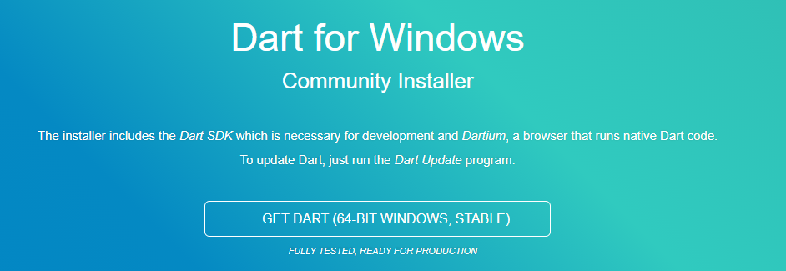
Instalasi Dart
1. Click Link Dibawah Ini :
https://gekorm.com/dart-windows/
2. Download fully tested version
3. Jalankan file yang telah didownload, tekan tombol “next” seterusnya hingga “finish”
Notes:
Save Time....:
The Platform will house/aggregate thousands of DIRECT SUPPLIERS. Buyer members are now abled to easily Pick whats best suitable for them.
Discover...:
Suppliers need to be a registered and verified members. There will be features such as ratings and certifications to boost further.
Grow Business:
Members akan di-empowered dengan sebuah tool digital yang yang tadinya menyerang industri, malah justru membuat mereka bisa menjadi lebih kompetitif di era digital.

Slide 6




Dart Tools
DartPad
DartPad adalah open-source tools yang memungkinkan Anda bermain dengan bahasa Dart di perangkat apa pun. Link Akses : https://dartpad.dev/
IDEs and editors
Command-line tools
Windows Default : Command Prompt
Notes:
Save Time....:
The Platform will house/aggregate thousands of DIRECT SUPPLIERS. Buyer members are now abled to easily Pick whats best suitable for them.
Discover...:
Suppliers need to be a registered and verified members. There will be features such as ratings and certifications to boost further.
Grow Business:
Members akan di-empowered dengan sebuah tool digital yang yang tadinya menyerang industri, malah justru membuat mereka bisa menjadi lebih kompetitif di era digital.

Slide 7
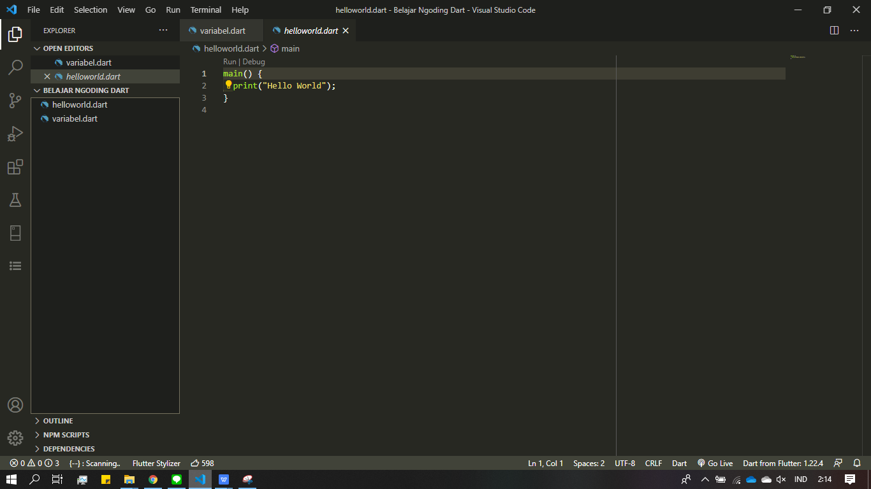
Konfigurasi IDE (1)
Recommended IDE :
Download VS Code : https://code.visualstudio.com/download
Silakan jalankan file hasil download
“next” hingga “finish”.
Kemudian, buka VS Code.
Notes:
Save Time....:
The Platform will house/aggregate thousands of DIRECT SUPPLIERS. Buyer members are now abled to easily Pick whats best suitable for them.
Discover...:
Suppliers need to be a registered and verified members. There will be features such as ratings and certifications to boost further.
Grow Business:
Members akan di-empowered dengan sebuah tool digital yang yang tadinya menyerang industri, malah justru membuat mereka bisa menjadi lebih kompetitif di era digital.

Slide 8
Konfigurasi IDE (2)
Click Icon yang ditunjuk
Notes:
Save Time....:
The Platform will house/aggregate thousands of DIRECT SUPPLIERS. Buyer members are now abled to easily Pick whats best suitable for them.
Discover...:
Suppliers need to be a registered and verified members. There will be features such as ratings and certifications to boost further.
Grow Business:
Members akan di-empowered dengan sebuah tool digital yang yang tadinya menyerang industri, malah justru membuat mereka bisa menjadi lebih kompetitif di era digital.

Slide 9
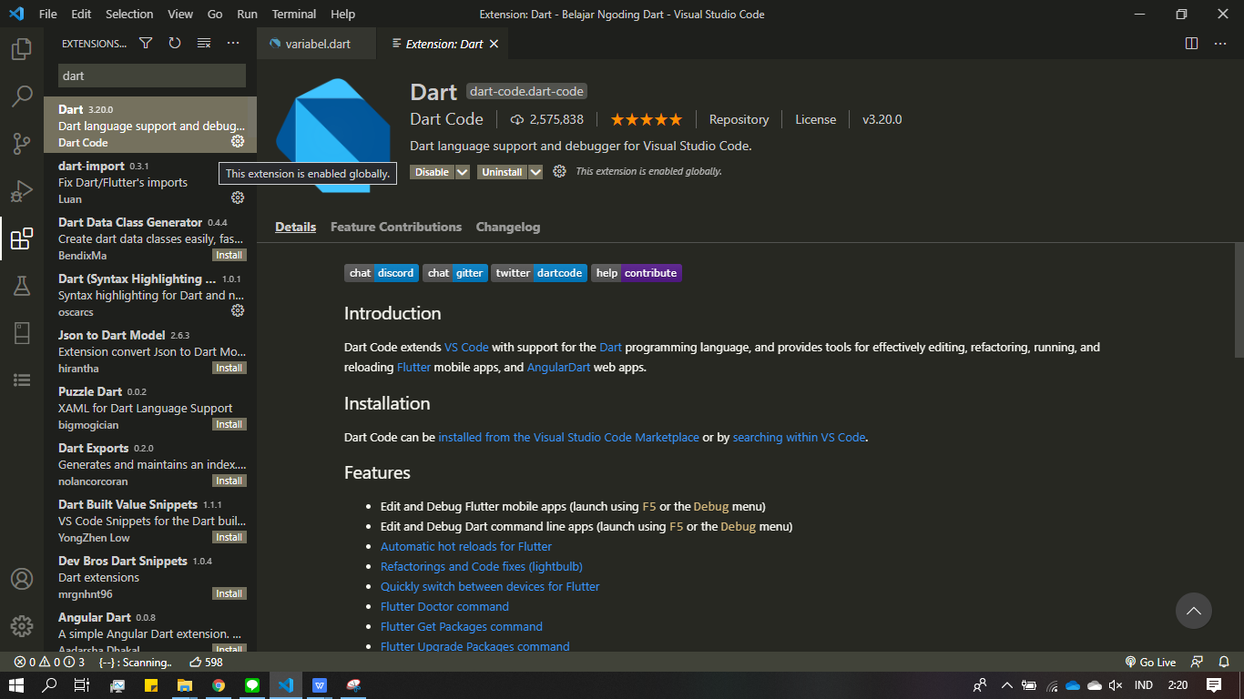
Konfigurasi IDE (3)
Ketik “Dart” dan tekan tombol “Install”
Notes:
Save Time....:
The Platform will house/aggregate thousands of DIRECT SUPPLIERS. Buyer members are now abled to easily Pick whats best suitable for them.
Discover...:
Suppliers need to be a registered and verified members. There will be features such as ratings and certifications to boost further.
Grow Business:
Members akan di-empowered dengan sebuah tool digital yang yang tadinya menyerang industri, malah justru membuat mereka bisa menjadi lebih kompetitif di era digital.

Slide 10


Konstruksi Dasar Dart Programming (1) : Hello World
Buat sebuah file di VS Code dengan men-click icon yang ditunjuk.
Buat extensi file “.dart”
contoh : belajarkoding.dart
Silahkan ketik script kode pada editor.
Click icon berikut pada sudut kiri bawah.
Notes:
Save Time....:
The Platform will house/aggregate thousands of DIRECT SUPPLIERS. Buyer members are now abled to easily Pick whats best suitable for them.
Discover...:
Suppliers need to be a registered and verified members. There will be features such as ratings and certifications to boost further.
Grow Business:
Members akan di-empowered dengan sebuah tool digital yang yang tadinya menyerang industri, malah justru membuat mereka bisa menjadi lebih kompetitif di era digital.

Slide 11
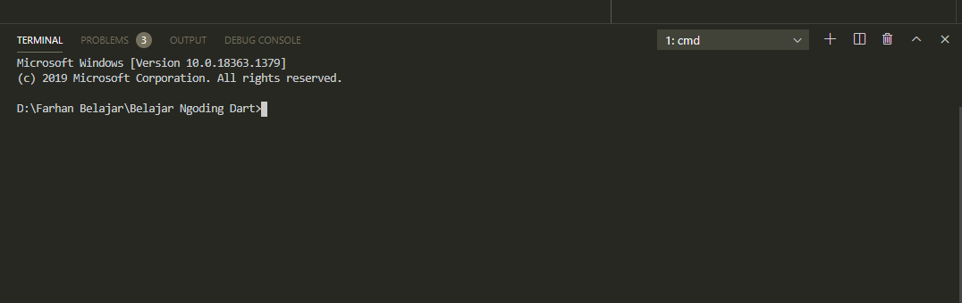
Konstruksi Dasar Dart Programming (2) : Hello World
Pilih terminal, dan akan muncul tampilan seperti berikut.
Silahkan ketik “dart nama_file.dart” pada terminal
untuk menjalakan program
contoh :
Notes:
Save Time....:
The Platform will house/aggregate thousands of DIRECT SUPPLIERS. Buyer members are now abled to easily Pick whats best suitable for them.
Discover...:
Suppliers need to be a registered and verified members. There will be features such as ratings and certifications to boost further.
Grow Business:
Members akan di-empowered dengan sebuah tool digital yang yang tadinya menyerang industri, malah justru membuat mereka bisa menjadi lebih kompetitif di era digital.

Slide 12
Konstruksi Dasar Dart Programming (3) : Variabel
Variabel adalah sebuah tempat yang digunakan untuk menyimpan nilai. Sedangkan tipe data adalah jenis nilai yang akan kita simpan.
Tipe data dasar pada Dart dibagi menjadi tiga macam:
Tipe data Angka (Number): int, double
Tipe data teks: String
Tipe data boolean: bool
Systax :
tipe_data nama_variabel = isi_variabel;
contoh :
int angkaSatu = 1;
double angkaDesimal = 1.2;
String nama = “Farhan Yusri”;
bool iniSalah = false;
Notes:
Save Time....:
The Platform will house/aggregate thousands of DIRECT SUPPLIERS. Buyer members are now abled to easily Pick whats best suitable for them.
Discover...:
Suppliers need to be a registered and verified members. There will be features such as ratings and certifications to boost further.
Grow Business:
Members akan di-empowered dengan sebuah tool digital yang yang tadinya menyerang industri, malah justru membuat mereka bisa menjadi lebih kompetitif di era digital.

Slide 13
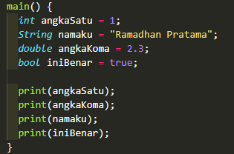
Konstruksi Dasar Dart Programming (3) : Variabel
Contoh kode :
Notes:
Save Time....:
The Platform will house/aggregate thousands of DIRECT SUPPLIERS. Buyer members are now abled to easily Pick whats best suitable for them.
Discover...:
Suppliers need to be a registered and verified members. There will be features such as ratings and certifications to boost further.
Grow Business:
Members akan di-empowered dengan sebuah tool digital yang yang tadinya menyerang industri, malah justru membuat mereka bisa menjadi lebih kompetitif di era digital.

Slide 14
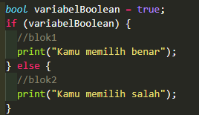
Konstruksi Dasar Dart Programming (3) : Pengendali Alur
Pada umumnya, variabel boolean digunakan untuk mengendalikan alur. Perhatikan program berikut :
Pada Program diatas terlihat bahwa nilai dari variabelBoolean adalah true.
Jika variabelBoolean bernilai true, akan menjalankan program pada blok1
Jika variabelBoolean bernilai false, akan menjalakan program pada blok2
Notes:
Save Time....:
The Platform will house/aggregate thousands of DIRECT SUPPLIERS. Buyer members are now abled to easily Pick whats best suitable for them.
Discover...:
Suppliers need to be a registered and verified members. There will be features such as ratings and certifications to boost further.
Grow Business:
Members akan di-empowered dengan sebuah tool digital yang yang tadinya menyerang industri, malah justru membuat mereka bisa menjadi lebih kompetitif di era digital.

Slide 15
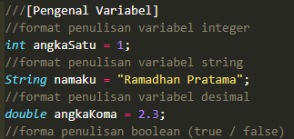
Konstruksi Dasar Dart Programming (3) : Komentar
Komentar adalah bagian systax yang tidak akan diproses ketika program dijalankan
Komentar umumnya digunakan oleh developer untuk mendefinisikan sebuah program yang sedang dibuat sebagai dokumentasi.
dalam komentar dapat diimplementasi dengan lambang // dan ///.
contoh :
Notes:
Save Time....:
The Platform will house/aggregate thousands of DIRECT SUPPLIERS. Buyer members are now abled to easily Pick whats best suitable for them.
Discover...:
Suppliers need to be a registered and verified members. There will be features such as ratings and certifications to boost further.
Grow Business:
Members akan di-empowered dengan sebuah tool digital yang yang tadinya menyerang industri, malah justru membuat mereka bisa menjadi lebih kompetitif di era digital.

Slide 16
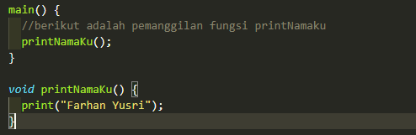
Konstruksi Dasar Dart Programming (3) : Fungsi
Fungsi adalah adalah satu blok kode yang melakukan tugas tertentu atau satu blok instruksi yang di eksekusi ketika dipanggil dari bagian lain dalam suatu program.
Fungsi memiliki 2 tipe;
memiki return (void)
tidak memiliki return
Fungsi yang tidak memiliki return merupakan fungsi yang tidak mengembalikan nilai apapun
Contoh :
Notes:
Save Time....:
The Platform will house/aggregate thousands of DIRECT SUPPLIERS. Buyer members are now abled to easily Pick whats best suitable for them.
Discover...:
Suppliers need to be a registered and verified members. There will be features such as ratings and certifications to boost further.
Grow Business:
Members akan di-empowered dengan sebuah tool digital yang yang tadinya menyerang industri, malah justru membuat mereka bisa menjadi lebih kompetitif di era digital.

Slide 17
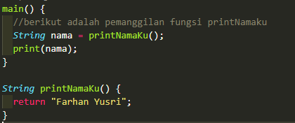
Konstruksi Dasar Dart Programming (3) : Fungsi
Fungsi memiliki return merupakan fungsi yang mengembalikan nilai.
Pada umumnya nilai tersebut akan dimasukkan terlebih dahulu kedalam sebuah variabel.
Notes:
Save Time....:
The Platform will house/aggregate thousands of DIRECT SUPPLIERS. Buyer members are now abled to easily Pick whats best suitable for them.
Discover...:
Suppliers need to be a registered and verified members. There will be features such as ratings and certifications to boost further.
Grow Business:
Members akan di-empowered dengan sebuah tool digital yang yang tadinya menyerang industri, malah justru membuat mereka bisa menjadi lebih kompetitif di era digital.

Slide 18
Konstruksi Dasar Dart Programming (3) : Fungsi
Fungsi memiliki return merupakan fungsi yang mengembalikan nilai.
Pada umumnya nilai tersebut akan dimasukkan terlebih dahulu kedalam sebuah variabel.
Notes:
Save Time....:
The Platform will house/aggregate thousands of DIRECT SUPPLIERS. Buyer members are now abled to easily Pick whats best suitable for them.
Discover...:
Suppliers need to be a registered and verified members. There will be features such as ratings and certifications to boost further.
Grow Business:
Members akan di-empowered dengan sebuah tool digital yang yang tadinya menyerang industri, malah justru membuat mereka bisa menjadi lebih kompetitif di era digital.

Slide 19
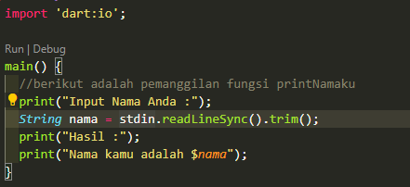
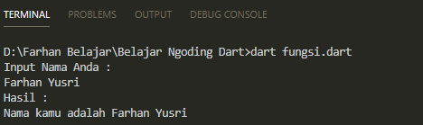
Konstruksi Dasar Dart Programming (3) : Library
Library adalah kumpulan code yang biasanya terkumpul dalam sebuah module/ package yang dapat di import/ reuse ke program lain.
Bahasa dari memiliki banyak library seperti async, collection, convert, io, dll.
Pada pertemuan awal ini kita akan membahas library input output (dart:io).
dart:io memungkin para developer untuk menginputkan nilai pada terminal
seperti contoh berikut :
Notes:
Save Time....:
The Platform will house/aggregate thousands of DIRECT SUPPLIERS. Buyer members are now abled to easily Pick whats best suitable for them.
Discover...:
Suppliers need to be a registered and verified members. There will be features such as ratings and certifications to boost further.
Grow Business:
Members akan di-empowered dengan sebuah tool digital yang yang tadinya menyerang industri, malah justru membuat mereka bisa menjadi lebih kompetitif di era digital.

Slide 20
DISCLAIMER
The information in this presentation is provided to you by PT. AXAR Technology Raya, solely for informational purposes and does not constitute an offer to buy, sell or issue, or a solicitation of an offer to sell, buy or acquire any securities of the Company in any jurisdiction or an inducement to enter into investment activity, nor may it or any part of it form the basis of or be relied on in connection with any contract or commitment whatsoever. No representations or warranties, express or implied, are made by the Company, any underwriters, any of their respective affiliates, directors, officers, employees, advisors or representatives with respect to, and no reliance should be placed, on the accuracy, fairness or completeness of the information presented or contained in this presentation. By viewing this presentation, you agree that none of the Company, any underwriters, nor any of their respective affiliates, directors, officers, employees, advisors or representatives accepts any responsibility or liability whatsoever for any loss howsoever arising from any information presented or contained in or derived from or omitted from this presentation. The information presented or contained in this presentation was obtained from various sources, including certain third parties, and has not been independently verified, and its accuracy is not guaranteed.
This presentation does not contain all relevant information relating to the Company or its securities, particularly with respect to the risks and special considerations involved with an investment in the securities of the Company. These materials are not an offer of securities for sale. Any public offering will be made by means of a prospectus that may be obtained from the issuer and that will contain detailed information about the company and management, as well as financial statements. This presentation speaks as of its date and the information presented or contained in this presentation is subject to change without notice or update.
This presentation contains statements that constitute forward-looking statements. These statements include descriptions regarding the intent, belief or current expectations of the Company or its officers about the future. These statements can be recognized by the use of words such as “expects,” “plans,” “will,” “estimates,” “projects,” “intends,” or words of similar meaning. Such forward-looking statements are not guarantees of future performance and involve risks and uncertainties, and actual results may differ from those in the forward-looking statements as a result of various factors and assumptions, many of which are beyond the Company’s control. The Company or any of its affiliates, advisors, representatives or underwriters has no obligation and does not undertake to revise forward-looking statements to reflect future events or circumstances.
THE INFORMATION CONTAINED IN THIS DOCUMENT IS HIGHLY CONFIDENTIAL AND MAY NOT BE FORWARDED, PUBLISHED OR DISTRIBUTED, DIRECTLY OR INDIRECTLY, TO ANY OTHER PERSON (WHETHER WITHIN OR OUTSIDE YOUR ORGANIZATION/FIRM) FOR ANY PURPOSE AND MAY NOT BE REPRODUCED IN ANY MANNER WHATSOEVER. ANY FORWARDING, PUBLICATION, DISTRIBUTION OR REPRODUCTION OF THIS DOCUMENT IN WHOLE OR IN PART IS UNAUTHORIZED.
THANK YOU

